Slide 1
Air‑pollution prediction in smart city, deep learning approach
PRESENTED BY:
JAGADEESH REDDY PANDHIKUNTA - 16326041
AJAY PAVAN KUMAR REDDY GOPU - 16332139
YASWANTH GANDHAMUNENI. - 16327304
VENKATA SAIDEEP JAKKA. - 16329410

Slide 2
Context:
Abstract
Introduction
Related Works
Deep Learning Models
Materials and Methods
Results and Discussions
Conclusion
References

Slide 3
Abstract
Over the past few decades, due to human activities, industrialization, and urbanization, air pollution has become a life-threatening factor in many countries around the world.
Among air pollutants, Particulate Matter with a diameter of less than 2.5µm (PM2.5) is a serious health problem.
In this paper, we implemented a deep learning solution to predict the hourly forecast of PM2.5 concentration in Beijing, China, based on CNN-LSTM, with a spatial-temporal feature by combining historical data of pollutants, meteorological data, and PM2.5 concentration.

Slide 4
Introduction
The increase in the percentage of the urban population in the world shows that people more and more are moving to cities. According to United Nations (UN), the urban population as of 2020 is about 56.15%. And it is expected that it will become 68% of the world’s population will live in urban cities by 2050.
According to the World Health Organization WHO, almost 90% of people breathe polluted air that exceeds the limits of WHO guidelines in terms of air quality, bringing about respiratory problems

Slide 5
Intro continued
Traditional statistical methods have been widely used to process air quality forecasting problems such as Autoregressive Moving Average ARMA.
With the increase in the amount and the complexity of the data obtained, however, these methods can no longer meet the actual demand because of training-length time.
In this study, we designed a system for the Prediction of PM2.5 by utilizing advanced deep neural networks. We, therefore, proposed a hybrid CNN-LSTM forecasting model.

Slide 6
Related works
Authors in article analyse and study the prediction PM2.5 levels on 12 stations in Beijing using four models ARIMA, FBProphet (Facebook prophet), LSTM, and CNN. With historical air quality data, meteorological data, weather forecast data and concluded that LSTM performed than other 3 models.
Combination of Convolutional Neural Networks and Long Short-Term Memory, which automatically manipulates both the spatial and temporal features of the data
Authors verified the feasibility and practicability of CNN-LSTM to estimate PM2.5 concentration in Beijing, cumulated wind speed, and cumulated hours of rain over the last 24h. They showed that the CNN-LSTM model outperforms other models.

Slide 7
Deep learning models
In this work, our goal is to investigate the performances of several deep learning models to forecast the concentration of PM2.5. Thus, we decided to use
LSTM
Bi-LSTM
GRU
CNN
CNN-LSTM

Slide 8
LSTM
LSTM is a type of recurrent neural network (RNN)
RNNs are a powerful type of artificial neural network and are most likely used for timeseries forecasting problems. However, RNNs frequently suffer from vanishing and exploding gradients.
LSTMs were created to solve these problems. LSTMs have longer memories and can learn from inputs that are separated from each other by long time lags

Slide 9
Gru and bi-lstm
GRU:
GRU, Gated recurrent unit is an advancement of the standard RNN [33] is included in RNN, and it is similar to an LSTM unit. Te GRU unit consists of the reset and updates gate.
BI-LSTM:
Standard RNN and LSTM often ignore future information in time-processing, while BiLSTM can take advantage of future information.

Slide 10
cnn
CNN has been successfully applied to computer vision and medical image analysis.
As in many CNN architectures, the deeper the layers get, the higher the number of flters.

Slide 11
Cnn-lstm
ConvLSTM architecture merges the capabilities of CNN and LSTM Network.
In the frst part of this model, convolutional layers extract essential features of input data, and the results are fattened in a 1-D tensor so that they can be used as input for the second part of the model (LSTM).

Slide 12
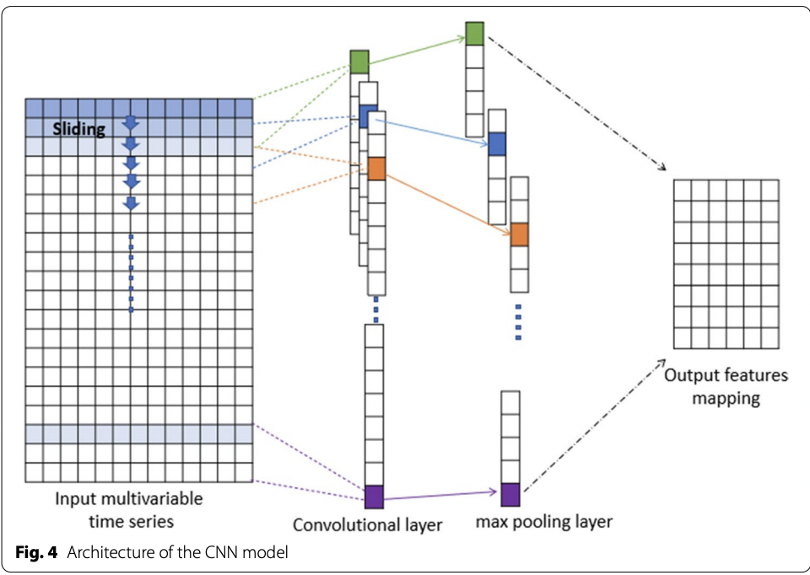
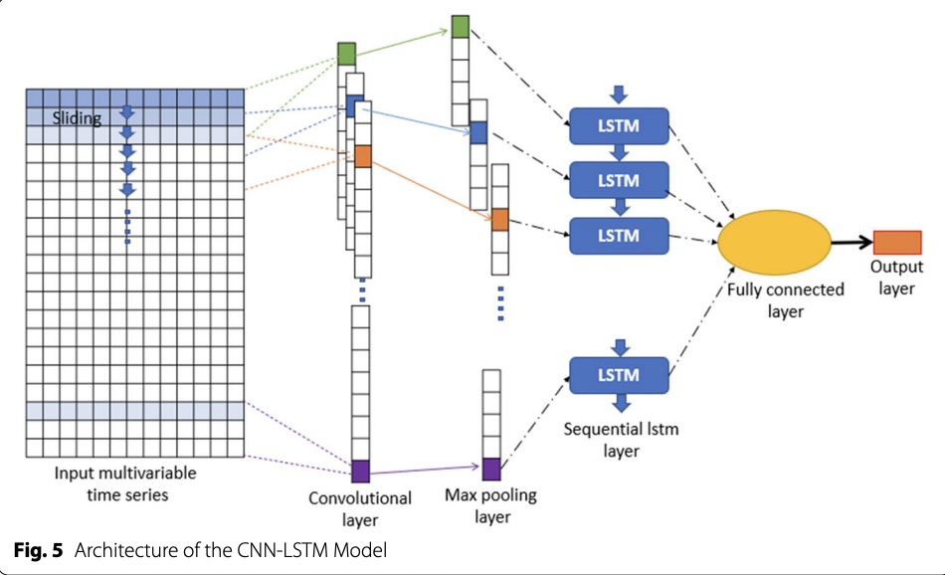
Cnn-lstm

Slide 13
Material and methods
Dataset
Dataset chosen in this article (420768 instances and 18 attributes) comes from the UCI Machine Learning Repository.
This dataset shows the concentration of air pollutants and air quality at 12 cites.
The air quality data comes from the Beijing Municipal Environmental Monitoring Center.

Slide 14
Data Pre-processing:
Missing Values: Linear interpolation method is the best method to estimate hourly monitoring data for PM10 for all percentages of simulated missing values.
Encoding categorical variables: It divides the compass into 16 sectors, Basically encodes the wind direction.
Normalization: In order to improve the prediction accuracy, we normalize the values of PM2.5 concentration using the Min-Max normalization

Slide 15
Feature selection: Finding the relationship between the input and output variables to reduces the complexity of training and improves performance. Pearson correlation is the most popular method used to fnd the correlation between two variables.
Air quality feature: We calculated the correlations between the features, of the air quality and we found a high correlation value between PM2.5, PM10, and CO

Slide 16
Results and discussions
In this research, the prediction of the concentration of PM2.5 was simulated using various deep-learning models. In this section, the historical observation PM2.5 data are compared with the computed PM2.5 from artifcial neural networks such as LSTM, GRU, Bi-LSTM, Bi-GRU, CNN, CNN-LSTM, and CNN-GRU tested in one and seven lag days.
In 65 models, the RMSE values for the 1-day lags were the smallest. However, the results show that the CNN-LSTM performed best in a one-hour forecast compared to other models under the same conditions, and diferent batches sizes. Moreover, these results show that the CNN-LSTM with 32 in batch size is more accurate in the diferent lags, with an advantage in 1-day lag.

Slide 17
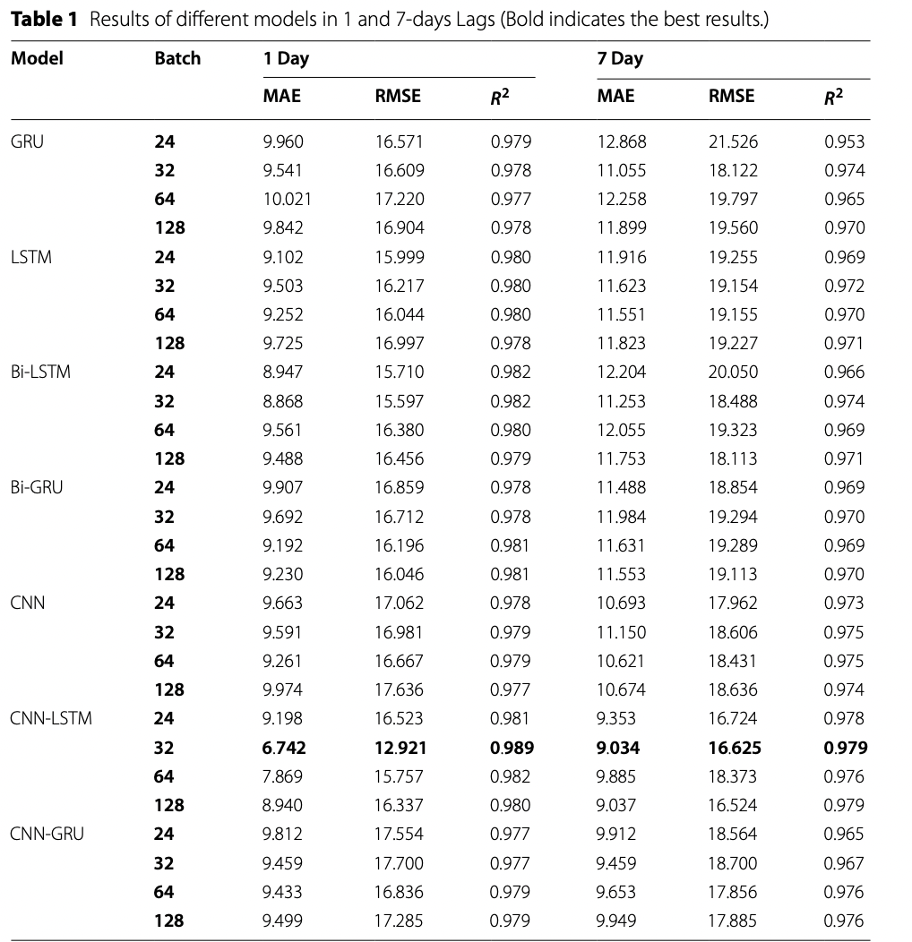
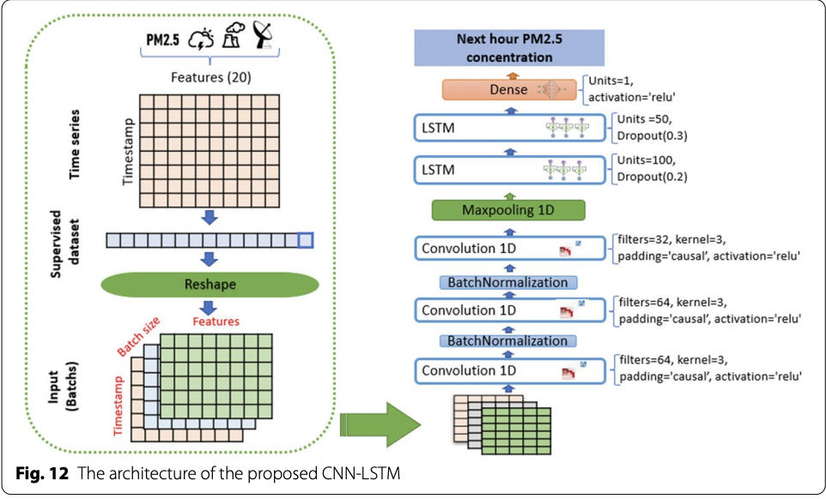

Slide 18
conclusion
In this paper the author proposed CNN-LSTM layer to predict the air-pollution in smart cities using deep learning approach.
CNN-LSTM out-performed the remaining models.
The main findings of this paper are as follows: This model can effectively extract the temporal and spatial features of the data through CNN and LSTM, and it also has high accuracy and stability.

Slide 19
Journal reference
https://journalofbigdata.springeropen.com/articles/10.1186/s40537-021-00548-1

